Slide 1
The National Environment Management Authority
AUTOMATION OF ENVIRONMENTAL LICENSING
By
JOSEPH MAKAU
Head of EIA

Slide 2
1. What is EIA

Slide 3
Definition of EIA
EIA is a systematic examination to determine whether or not a proposed project/ activity will have adverse impacts on the environment.
It Proposes measures to optimize positive impacts and mitigation measures for the negative ones.
The aim is to ensure that the project is justified (environmentally), Fair (economically) and acceptable (socially and Politically?) – Ensures Sustainable development
EIA is an Environmental Sustainability mainstreaming tool in development projects
3
8/30/23
Notes:
3

Slide 4
LEGAL FRAMEWORK FOR EIA/EA
Article 69(1)(F) of the Constitution of Kenya, 2010 Obligates the state to establish systems of EIA, EA and monitoring of the environment
The Environmental Management and Co-ordination Act (EMCA) 1999, Part VI on Integrated Environmental Impact Assessment sections 58 to 67 provides for Strategic Environmental Assessment and Environmental Impact Assessment governance and procedures.
Second Schedule of EMCA, 1999- amendment, Legal Notice 31 of 2019 – provide a Risk Based Categorization of projects to undergo an EIA process
Environmental (Impact Assessment and Audit) Regulations, 2003 – operationalizes EMCA, 1999 provisions for EIA/EA
Amendment of the EIA regulations, 2019, Legal Notice No. 32 provide for processing of Summary Project Reports (SPR) for Low and medium risk project

Slide 5
Types of EIA reports and timelines
Summary Project report: for low and medium risk projects. 5 days screening and assessment for approval (R. 7 Legal Notice 32 of 2019).
Comprehensive EIA Project Report (PR) for low and medium risk projects with significant adverse environmental impacts. 21 days review for approval.
EIA Study Report (SR): for High risk projects as per second schedule of EMCA, 1999. 60 days review for approval by the Authority.

Slide 6
2. Automation of EIA Standard Operating Procedures

Slide 7
Summary Project Reports (SPR) for low risk Projects
Online submission of an Application accompanied by a Summary Project Report (SPR) and relevant attachments.
Automatic Invoicing of the applicable EIA fees
Digital payment module through E-citizen: Mobile money options, debit/Credit card payment, RTGS, Bank transfer options available
Automatic record and Referencing of the Project Report and Application:
Electronic Correspondence: Acknowledgement letter, Review decision, Approval all generated automatically and send on email.
Online screening and assessment of the SPR.
All SPRs are processed digitally at the 47 County offices:

Slide 8
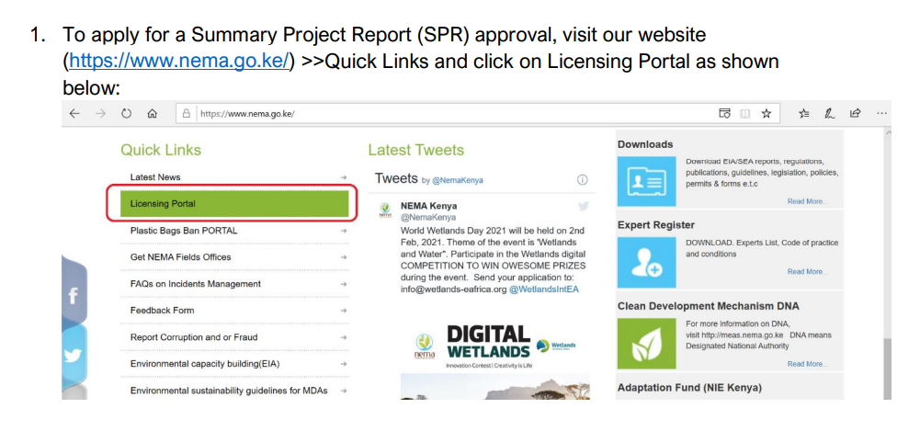
ONLINE SPR APPLICATION USER MANUAL

Slide 9
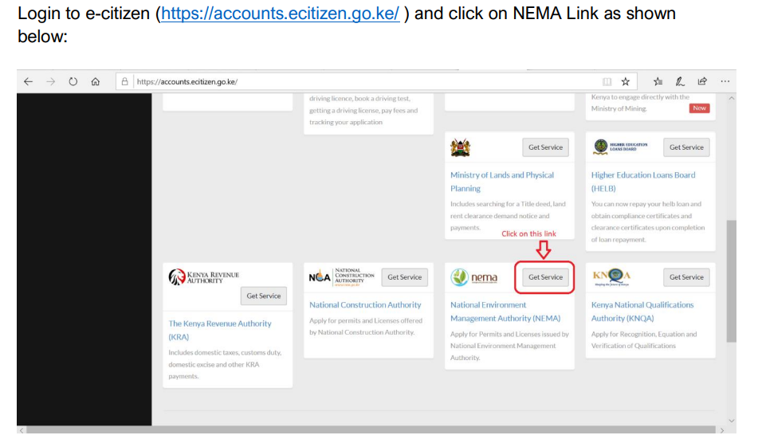
1. Login to Licensing portal: NEMA website/ E-citizen

Slide 10
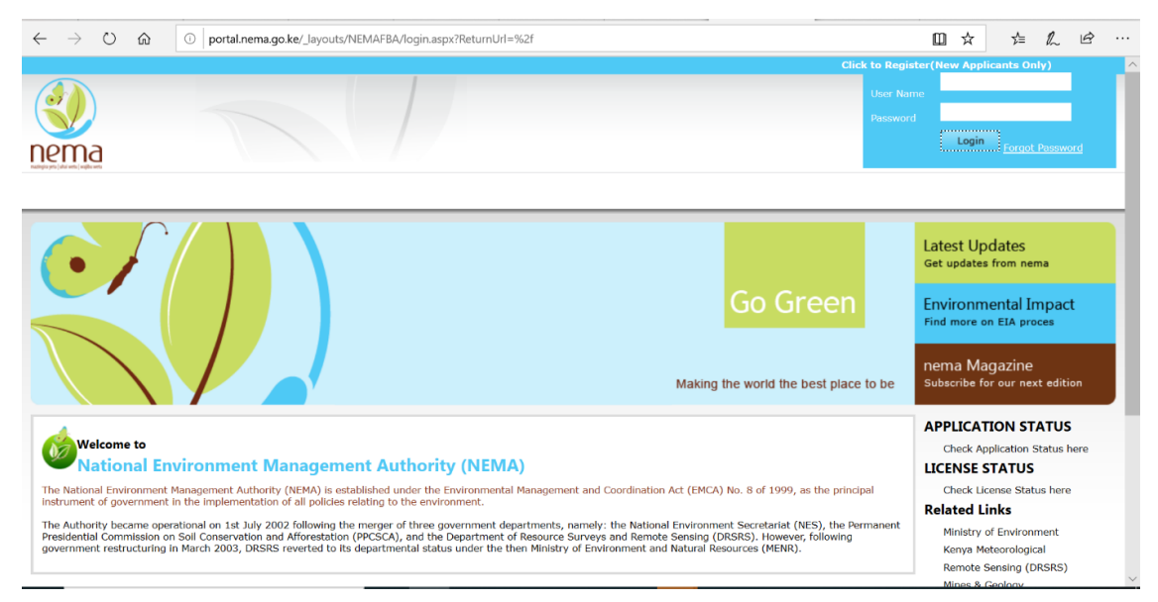
1. Login to Licensing portal: NEMA website/ E-citizen

Slide 11
1. Login to Licensing portal: NEMA website/ E-citizen

Slide 12
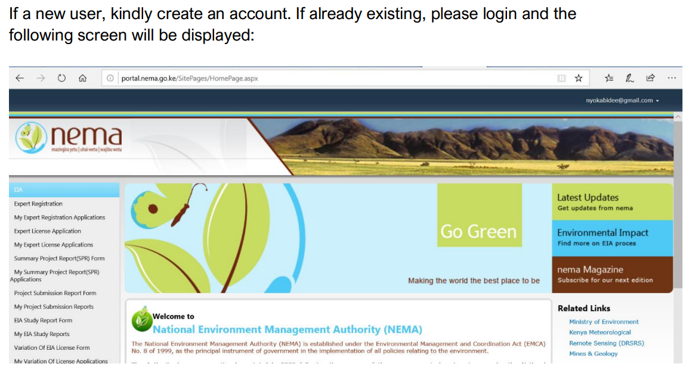
1. Login to Licensing portal: NEMA website/ E-citizen

Slide 13
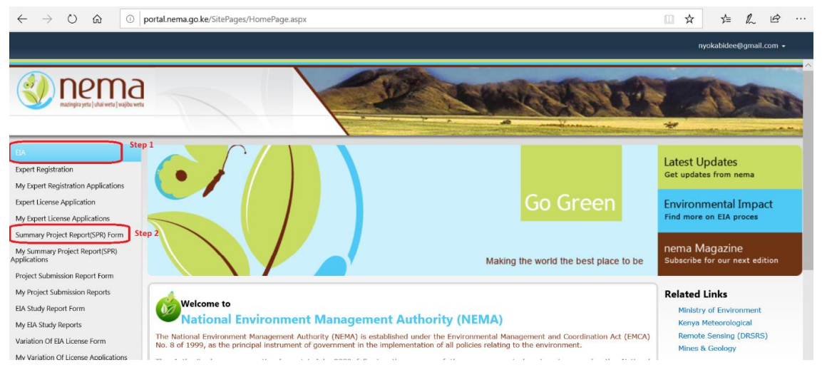
2. Apply for an SPR Approval click on EIA>>Summary Project Report (SPR)

Slide 14
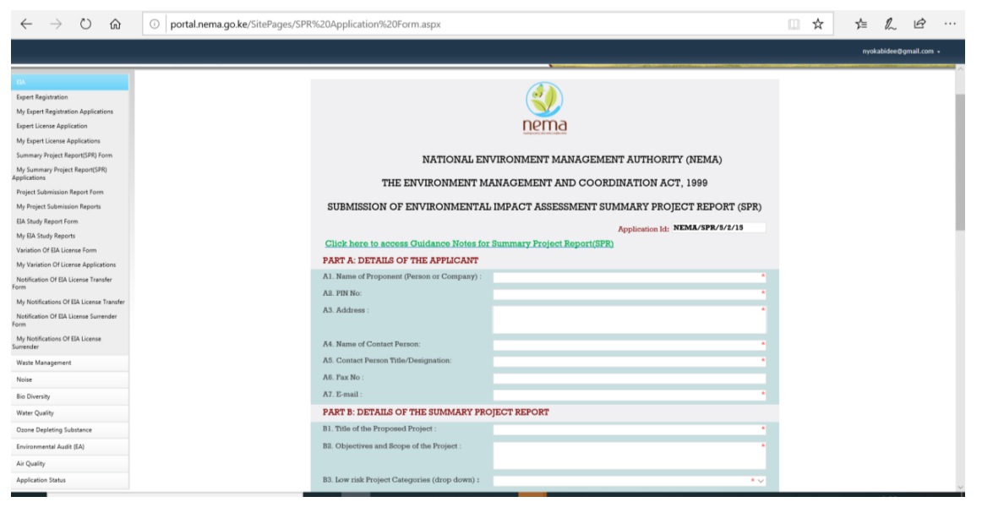
3. Fill the Summary Project Report (SPR) Application Form

Slide 15
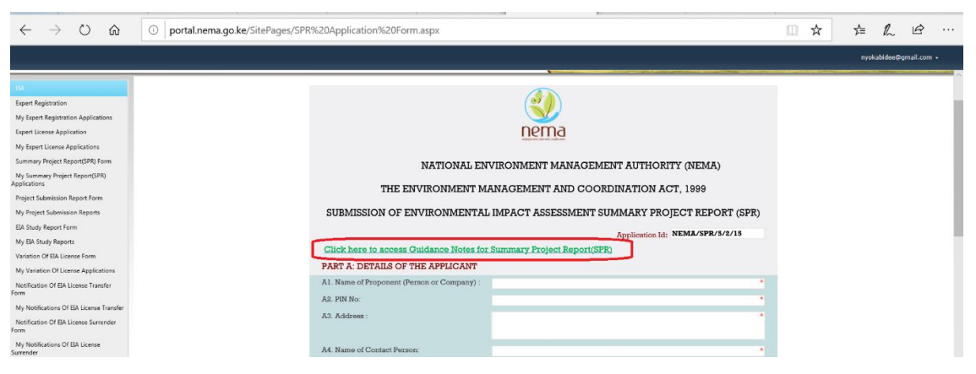
3. Guidance Notes on how to Fill the SPR Application Form

Slide 16
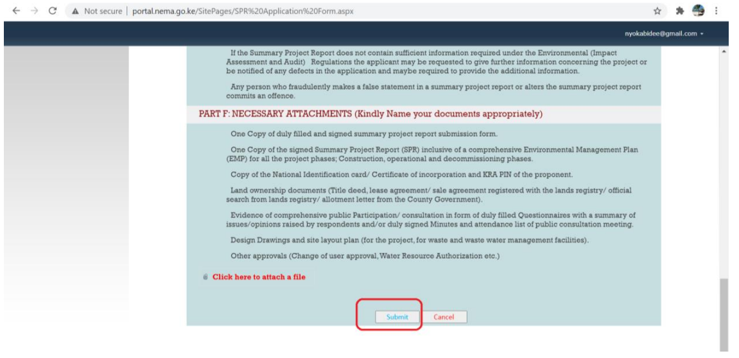
5. Submit successfully filled SPR Application Form

Slide 17
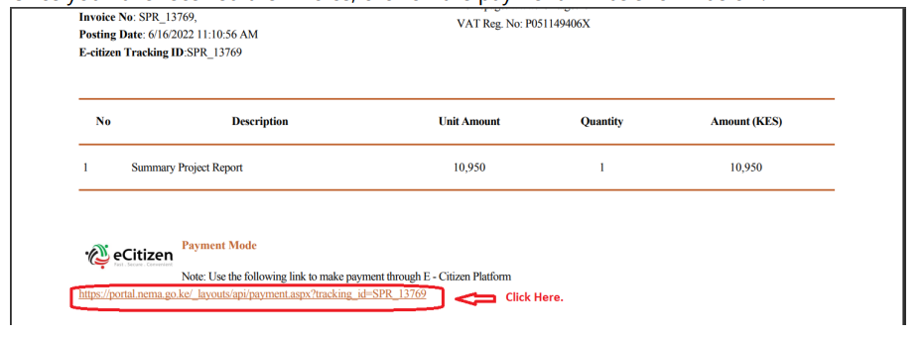
6. Invoice for the Applicable EIA processing and Monitoring Fees will be emailed upon submission of the form

Slide 18
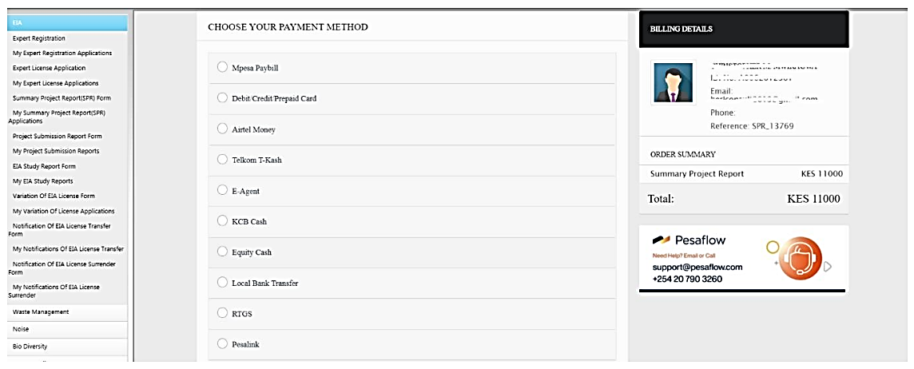
7. E-Citizen with different Payment Options

Slide 19
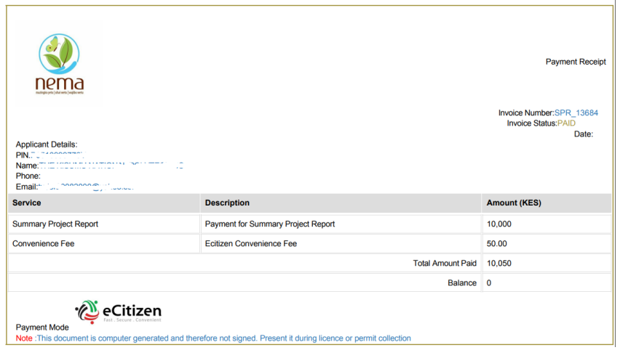
8. Payment Receipt will be emailed upon successful payment of the Amount Due- EIA fees

Slide 20
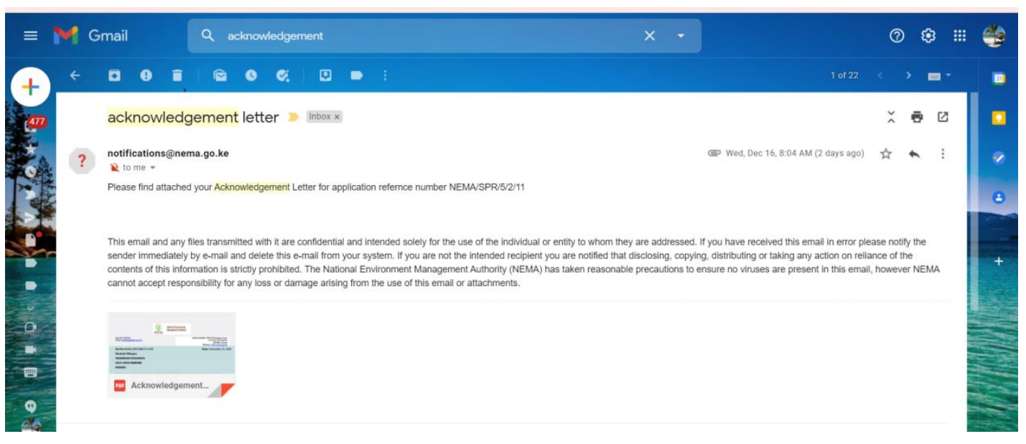
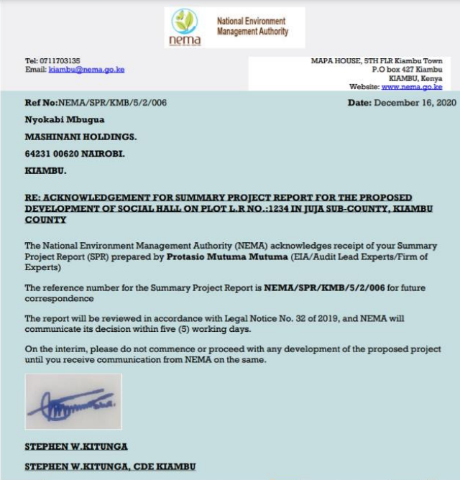
8. Acknowledgement Letter will be emailed after Receipt

Slide 21
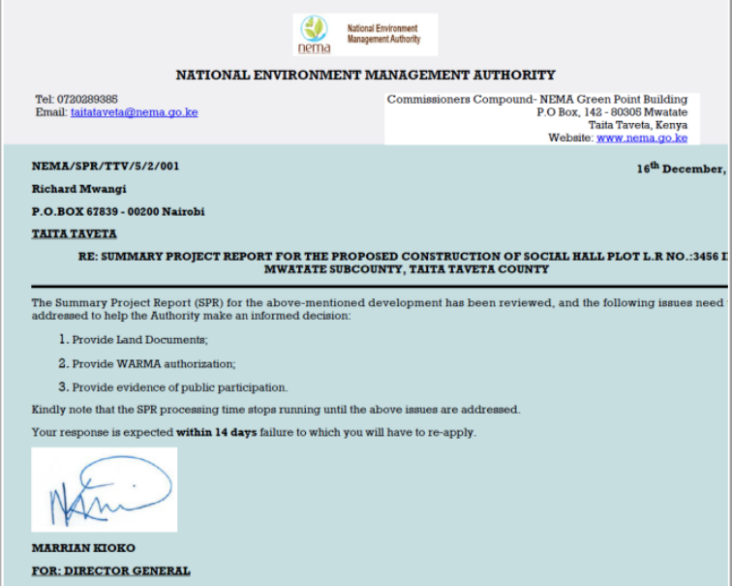
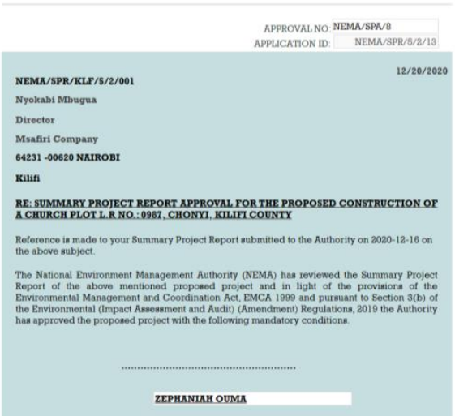
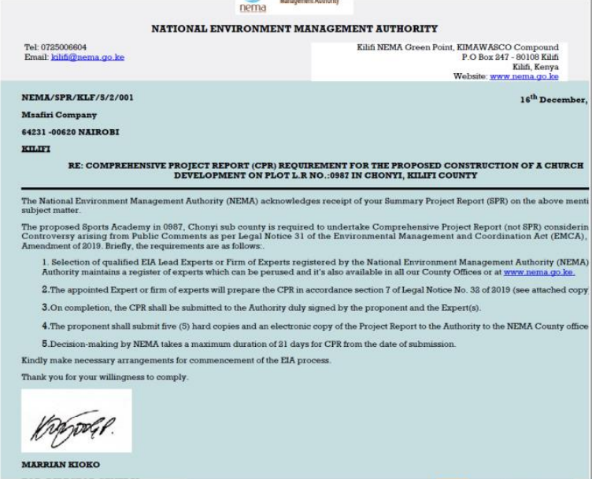
9. Within 5 days of Acknowledgement, the SPR will be reviewed and decision communicated on EMAIL

Slide 22
10. Record of Decision (RoD) on EIAs
Approval and Issuance of EIA license with conditions for the proposed project
Issues to be addressed: Pend approval until the adverse comments are addressed to the satisfaction of the Authority during which the EIA processing time stops running.
Upgrading of a Project Report to EIA Study Report noting the uncertainties in the associated risks, controversies and complexity associated with the proposed project.
Reject an application with reasons and advice on suitable and environmentally sound alternatives

Slide 23
3. EIA Performance Analysis:
Manual Vs Automated Licensing

Slide 24
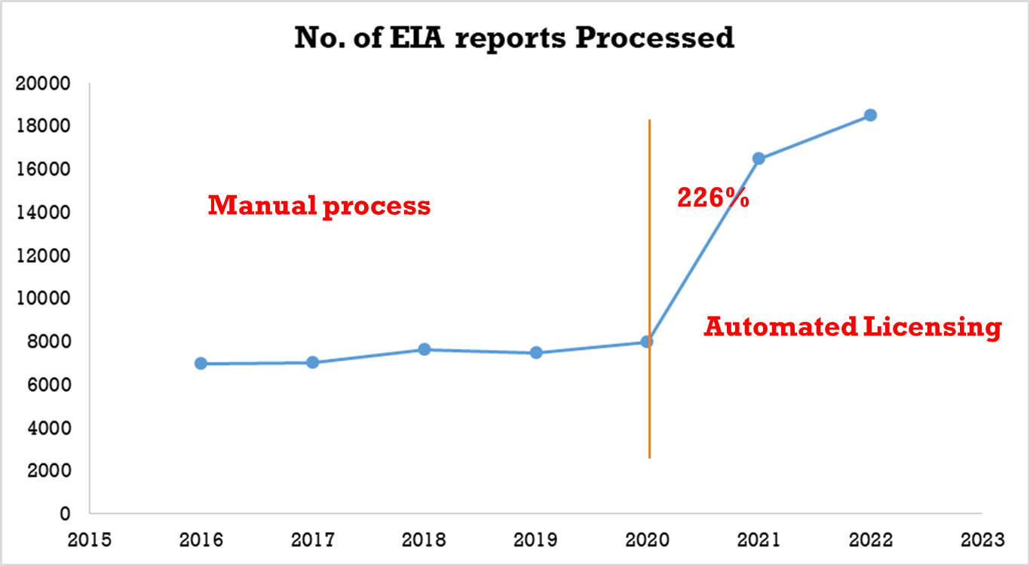
INNOVATION AND TRANSFORMATION OF EIA LICENSING PROCESS: MANUAL VS AUTOMATION
72,096 EIA Reports processed in 7 years (2016-2022)
Full Automation done in 2020
60% of all the licenses processed on line in 3 years
Automation = increased Environmental Compliance
Improved public service delivery: Digital convenient services
Improved client experience: Time and cost saving

Slide 25
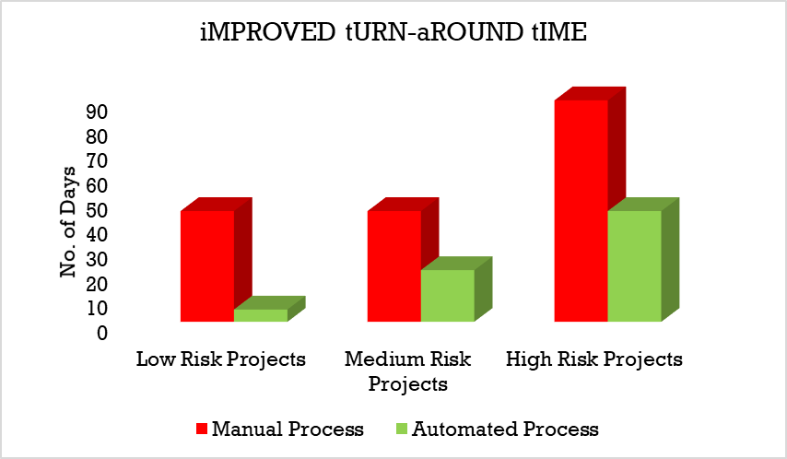
INNOVATION AND TRANSFORMATION OF EIA LICENSING PROCESS: MANUAL VS AUTOMATION
Reduced Processing time for all EIA categories
Time and cost saving in regulatory approval
Enhanced Ease of Doing Business environment in Kenya
Track record keeping and monitoring
90 Days
50%
45 Days
45 Days
45 Days
53%
90%
21 Days
5 Days

Slide 26
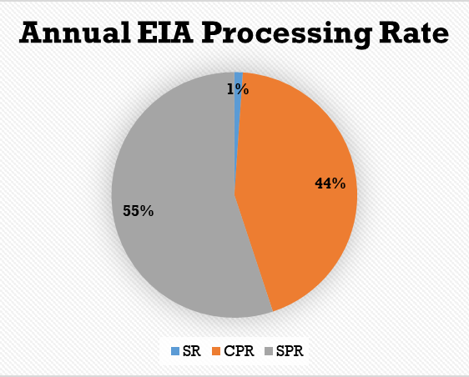
ANNUAL EIA PROCESSING RATE
18 Years of EIA Practice in Kenya
112 SR/Year
4,432 CPR/Year
3 year of SPR – 2019
5,572 SPR/Year
EIA professional network: Environmental Assessment Experts: 12,978

Slide 27
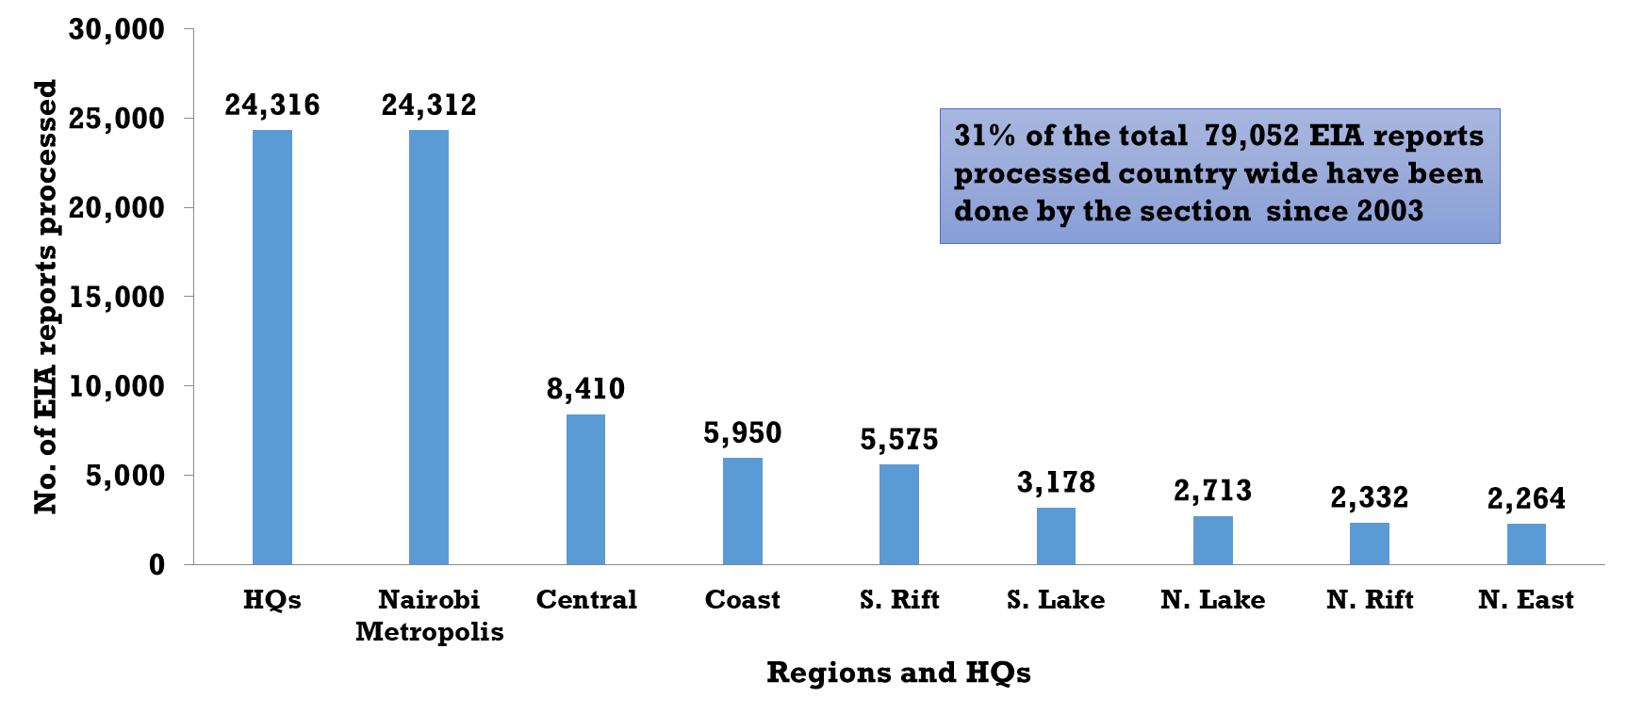
EIAs- HQs vs Regions (2021)

Slide 28
4. Mobil Automated Air Quality Monitoring

Slide 29
Mobile Air Quality Monitoring Laboratory

Slide 30
THANK-YOU

Slide 31
www.nema.go.ke
dgnema@nema.go.ke
@NemaKenya
NemaKenya
NEMA Kenya
NEMA Kenya

