Slide 1
HIGHLIGHTS ON WASTE MANAGEMENT
PATRICIA MUMBI WAMBUA
PRINCIPAL ENVIRONMENTAL EDUCATION & AWARENESS OFFICER
NEMA –KENYA HEADQUARTERS -NAIROBI

Slide 2
BAN ON PLASTICS (SINGLE-USE PLASTICS)
Kenya banned single-use plastic bags in 2017 – a move that was lauded as groundbreaking.
The national environmental authority says 80% of the public have complied with the ban.
In 2020, single-use plastics were prohibited in protected areas such as parks and forests.
The Sustainable Waste Management Act, No.31 of 2022, was signed into law on 7th July 2022.
It was developed by the Ministry of Environment and Forestry as a step towards implementation of the Ministry’s National Sustainable Waste Management Policy which came into force in February 2021.

Slide 3
SUSTAINABLE WASTE MANAGEMENT ACT,2022
objective
Establish the legal and institutional and legal framework for sustainable waste management
Objectives of the Act
General Principles
Article 42
Promote sustainable waste management
Realization of Article 42 of the CoK
Polluter pays,
Precautionary principle
Payment for ecosystem services
Zero waste principle
Promote effective delivery of waste management services
Reduce and prohibit waste disposal or Waste Management activities that contribute to pollution of air, water, land and marine environment.

Slide 4
WASTE MANAGEMENT ROLES - DUTIES
Private Citizen
Private sector entities
Public sector entities
Waste Service providers
County governments
NEMA
CS
Waste Management Council

Slide 5
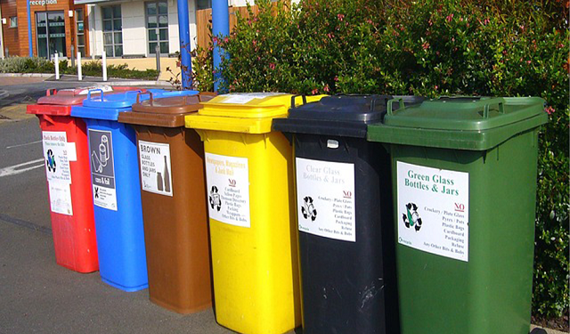
WASTE MANAGEMENT DUTIES
Private citizens
Private sector
Public sector
Segregate waste at source
Dispose waste to only licensed waste providers or at designated collection points
Offence, fine of Kshs 20, 000/= or 6 months or both
Properly segregate waste at source, place properly coded bins/respetacles to collect and handle waste as per the Act. S.12
Prepare a 3-year waste management plan and submit annual monitoring report to NEMA
Offence & Penalty
Repeat offence
0.5% net income registered in the previous tax year
Kshs. 20, 000/ for officer
Properly segregate waste at source
Accounting officer of a public entity shall be responsible for the management of waste generated in the entity
Offence and Penalty Offence

Slide 6
WASTE MANAGEMENT DUTIES CONTD.
WASTE SERVICE PROVIDERS –s.21
Handle waste as per the Act.
Deliver segregated waste collected to designated and licensed facilities.
Offence – Kshs. 50, 000/6 months imprisonment

Slide 7
WASTE MANAGEMENT DUTIES CONTD
Extended Producer Responsibility
Material recovery facility
Established by each county
For final sorting, segregation, composting and recycling
Every producer shall bear EPR to reduce pollution
EPR either individually or collectively

Slide 8
ROLE OF COUNTIES
Enact county sustainable waste management legislation within one year
Establish waste recovery facilities and recycling facilities and sanitary landfills for the disposable of non-recoverable waste
Incentivize the collection and separation of waste
Plan for waste management facilities in the city expansion

Slide 9
ROLE OF COUNTIES
Prepare a county waste management plan and quarterly monitoring reports
Submit annual reports to NEMA and county assembly on CWMP
Maintain data on waste management service providers

Slide 10
ROLE OF COUNTIES CONTD.
Prepare and submit to county assembly for approval the Integrated CWMP
Include ICWMP into county development plan
CEC envt, in each county shall develop a framework for inter-county co-operation on waste management
Est Material Recovery facilty (MRF) licenced by NEMA

Slide 11
ROLE OF NEMA
Monitor and review s.26
Develop regulations prescribing procedure for reporting on compliance; Require entities to to prepare reports on status of performance
Compliance and enforcement
Monitor investigate and report PP compliance
Monitor and enforce compliance with the Act
Receive CWMP from county government S.18

Slide 12
ROLE OF NEMA CONTINUED…………
Receive annual report from county government
Receive 3 year waste management plans from a private entity
Maintain records on waste management, allow access to the information
Prescribe fees for access information
License county MRF

Slide 13
ROLE OF NEMA CONTINUED…………
Issuance of restoration orders to a person who fails to clean up and restore site
Publish model county waste management legislation on a date CS appoints
Est a partnership programme with waste generating industries for continuous education to encourage compliance s.29
List of private entitles required to prepare waste management plans S.19(2)

Slide 14
CABINET SECRETARY- ENVIRONMENT
Within 6 months gazette the category of private sector entities that shall be required to prepare waste management plans
Gazette National Color Coding system of waste management in consultation with NEMA and county governments S.12(6)
Make regulations effecting the Act S.33
Develop regulations for the framework for inter-county co-operation on waste management s. 29
Develop a time table for county govts to adopt the Act and regulations made
EPR regulations within 2 years of this Act S.13

Slide 15
CABINET SECRETARY- ENVIRONMENT
Regulations for the establishment of proper management of MRFs
Incentives s.25
Locally produced and imported sustainable waste management equipment nd materials
Expand private investments in recycling ad waste management
With CS, finance prescribe incentives and make regulations for preferential use of recovered and recycled materials over newly manufactured ones

Slide 16
ROLE OF THE COUNCIL
Est by the CS within 1 year of the Act coming into operation
CS shall second a senior officer from the Ministry to be a Secretary to the Council
Functions include;
Enhance inclusive inter-governmental relations
Review progress of implementation of waste management strategy
Recommend to CS the national waste management recycling and recovery targets;
Synchronize the development of waste management sector;
Promote inter county waste management partnership county governments
Recommend to CS incentives to promote sustainable waste management
Perform other functions assigned by CS

Slide 17
MISC. PROVISIONS
Integrating waste management into school curricula
NECC shall est. a complaints and redress mechanism for this Act
NET for dispute resolution
FIRST SCHEDULE
Conduct of Business and affairs of the council
SECOND SCHEDULE
Provisions on Public Participation

Slide 20
HOW TO CONTACT US :
Our Headquarters is based at Eland House, Popo Road, off Mombasa Road, South C. We have offices in all counties.
National Environment Management Authority (NEMA) Kenya,
P.O Box 67839-00200, NAIROBI.
Tel : 254-20-2183718, 2101370.
Mobile : 0724253398, 0723363010, 0735 013046
Email : dgnema@nema.go.ke
Website : www.nema.go.ke

Slide 21
www.nema.go.ke
dgnema@nema.go.ke
@NemaKenya
National Environment Management Authority-Kenya
NEMA Kenya
NEMA Kenya

